Slide 1
Arduino Overview
Bob Wilton – KF5TPQ

Slide 2
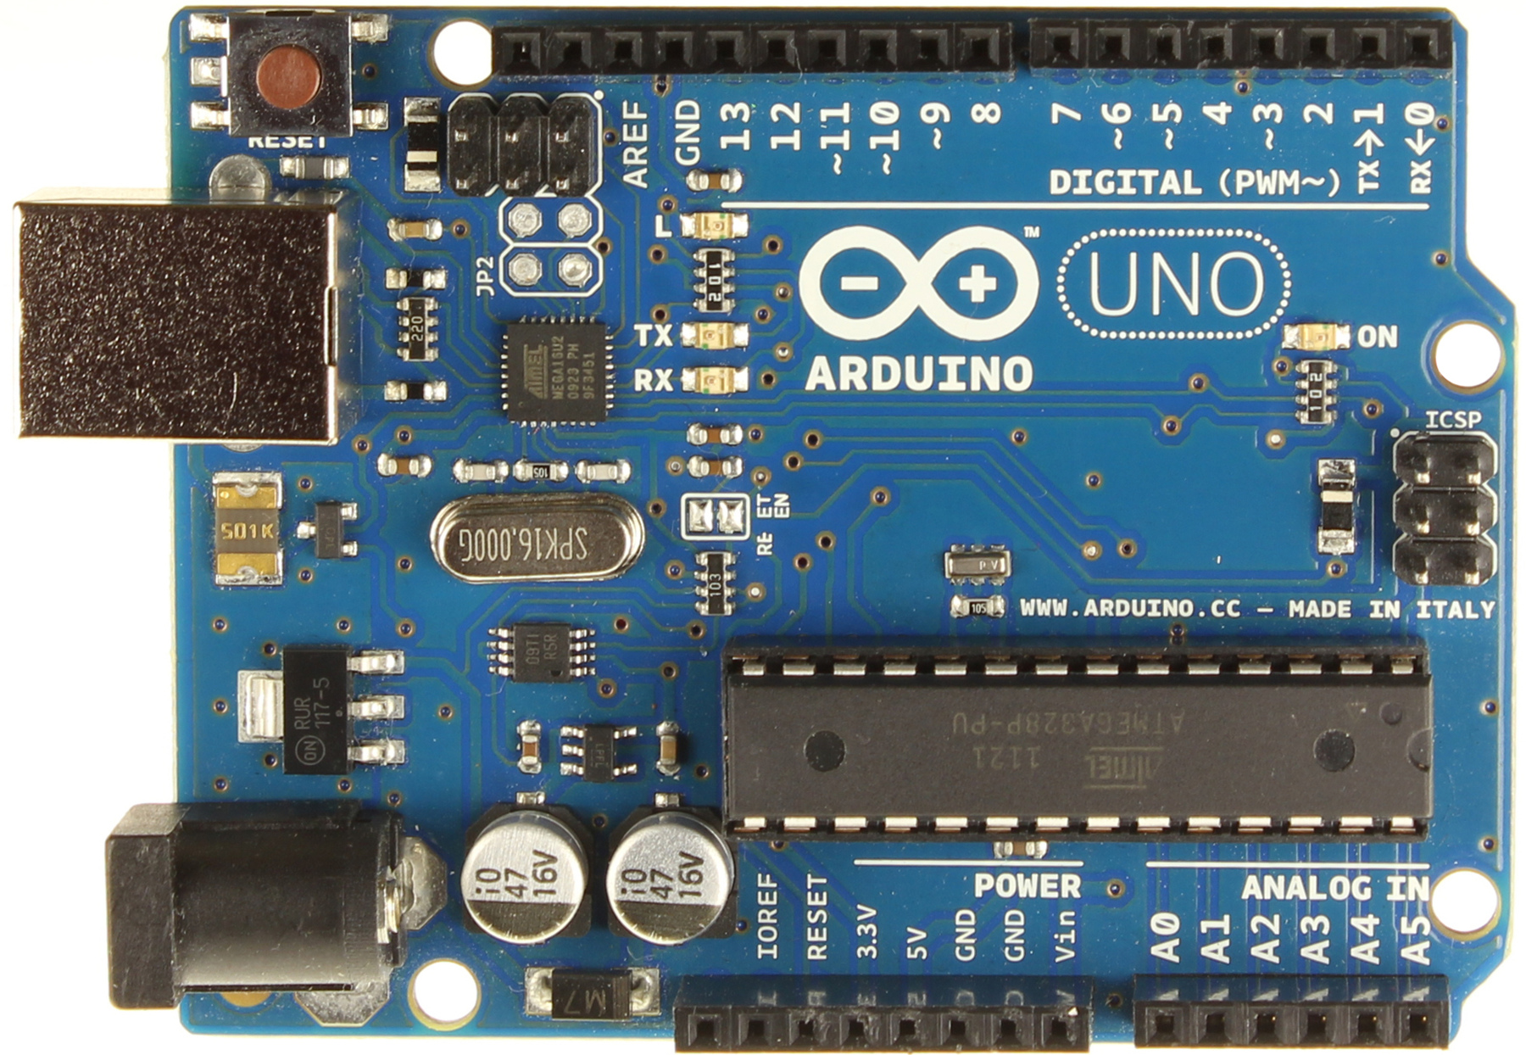
Arduino UNO

Slide 3
Arduino UNO
It is a MicroController
Atmel ATMega328 chip 16 Mhz (8 bit microcontroller)
14 Digital I/O Pins (6 can be PWM) (Mega 54/15)
6 Analog Pins (Mega 16)
Serial TX/RX for USB and serial communications (Mega(4)
I2C, SPI and Single Wire interfaces
32KB Flash Memory (Mega 256K)
2KB Sram and 1KB EEPROM (Mega 8K & 4K)
5 Volts (input 7-12 volts)

Slide 4
Arduino History
Developed in Italy as a teaching aid
Massimo Banzi and David Cuartielles
2 Factions now – Arduino.cc and Arduino.org
Open Source – Hardware and Software
Low cost – many clones
Many Varieties
Shield Boards
Sensors

Slide 5
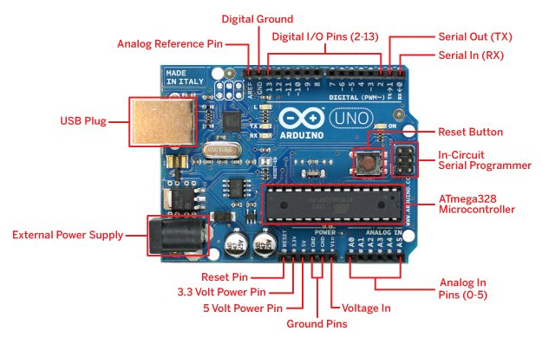
Arduino layout

Slide 6
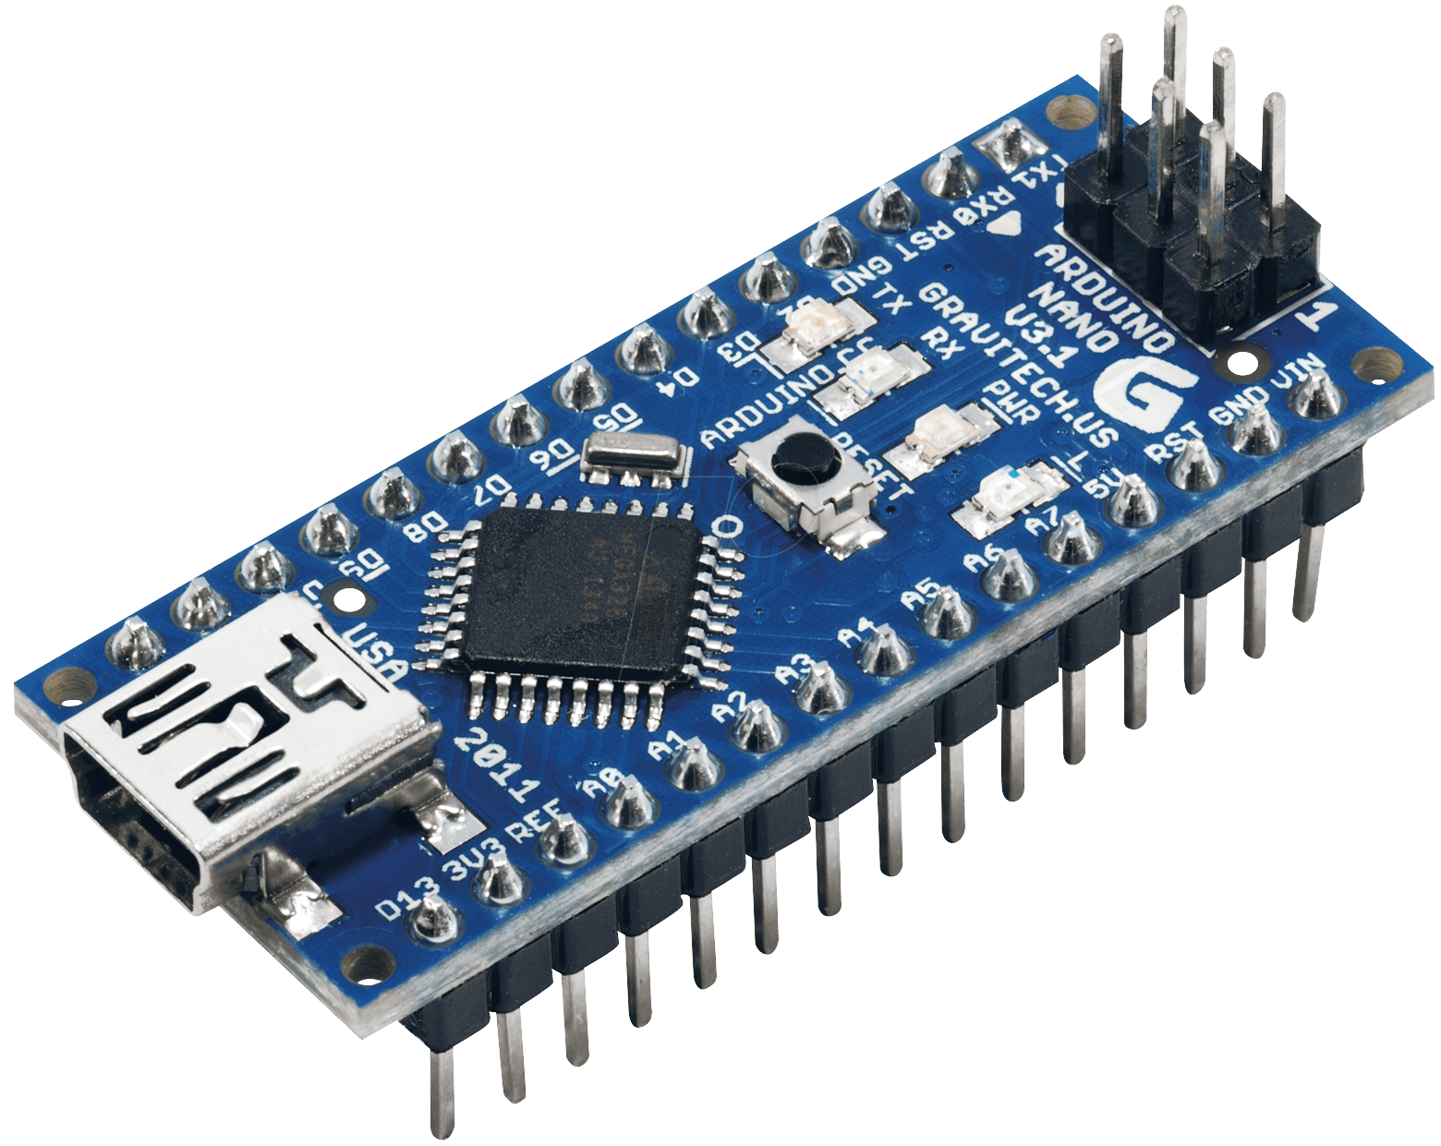
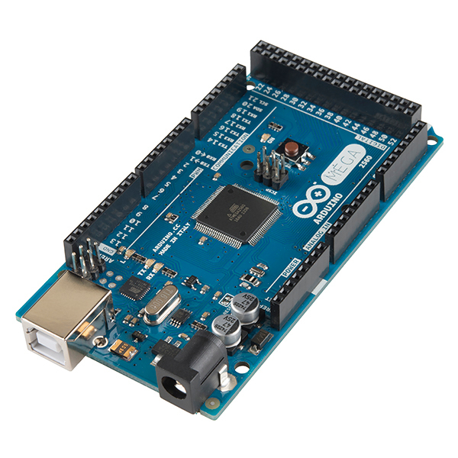
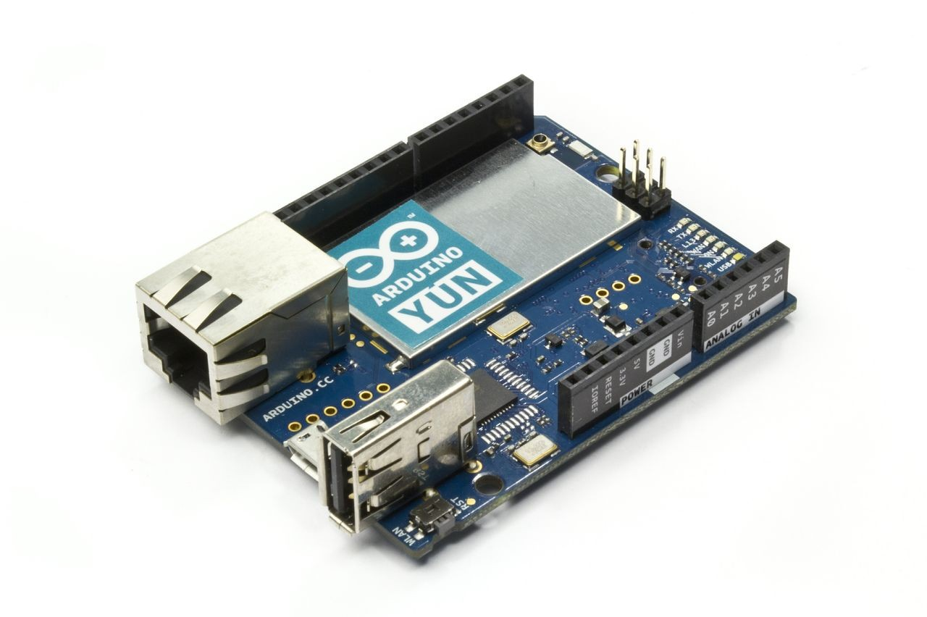
Arduino – Other Types

Slide 7
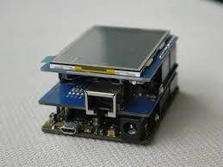
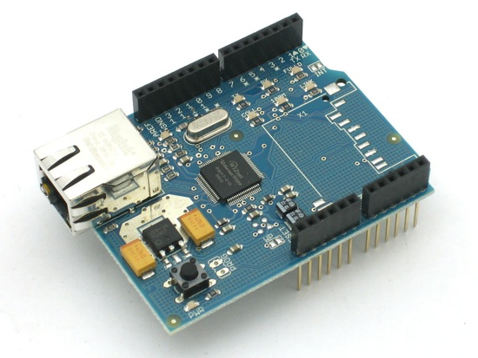
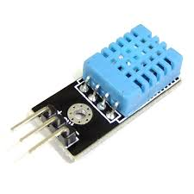
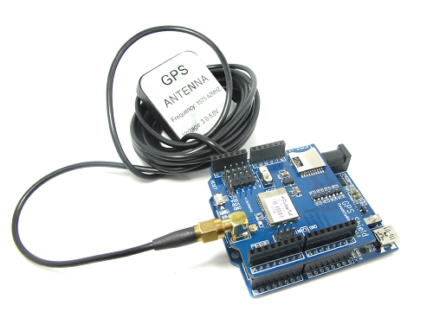
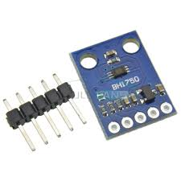
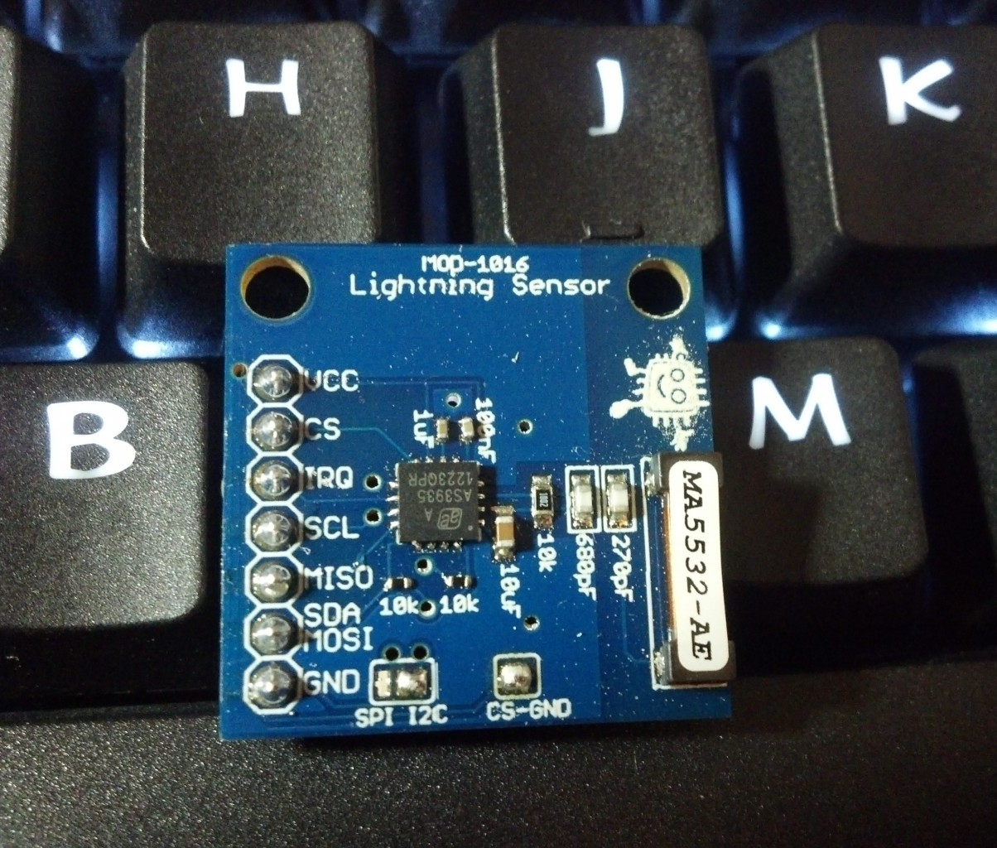
Arduino Shields & sensors

Slide 8
What can you do with Arduino
Learn more about Hardware and Software
Build your own electronic projects
IoT – Internet of Things
Home Automation
Integrate with Ham Radio
GPS / APRS
Lightning Detector
Weather Station
SWR Meter
Antenna Axis Controller
Morse Code Decoder
Waveform Generator

Slide 9
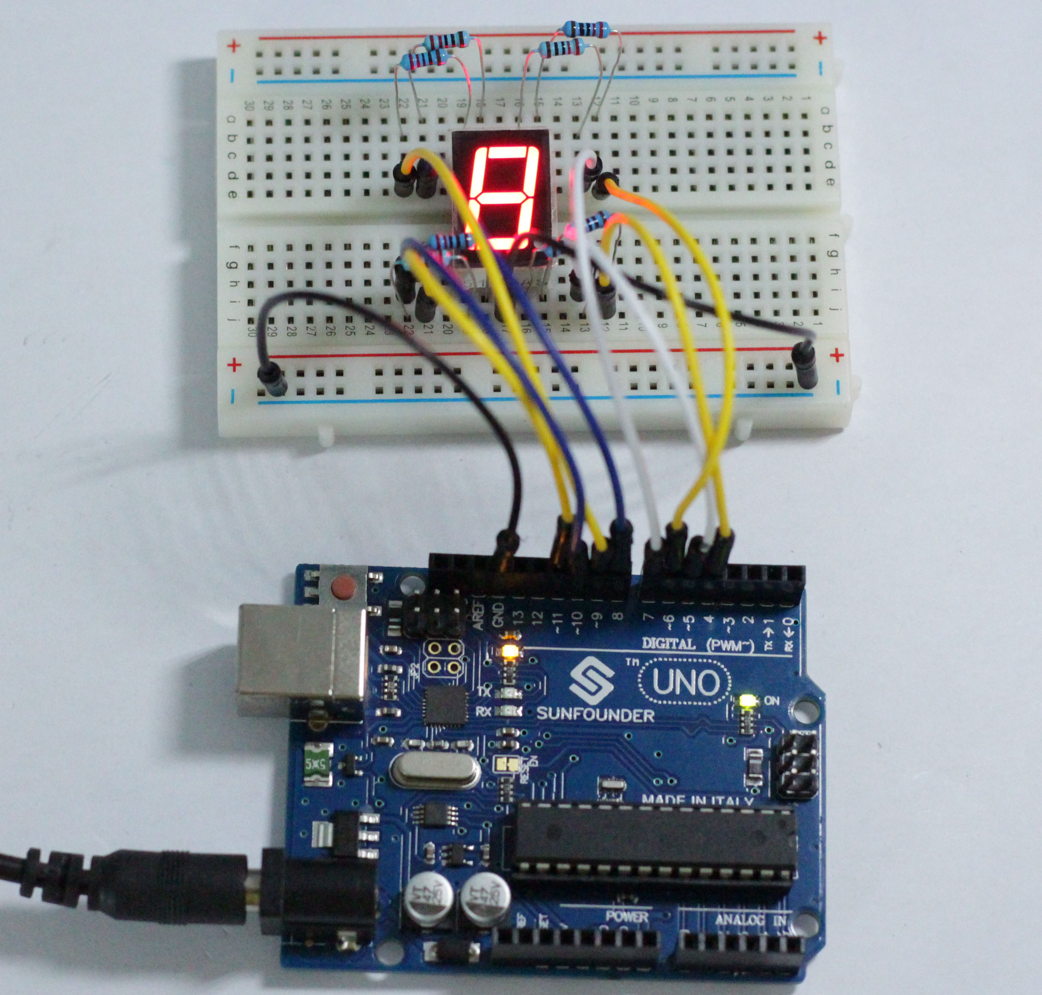
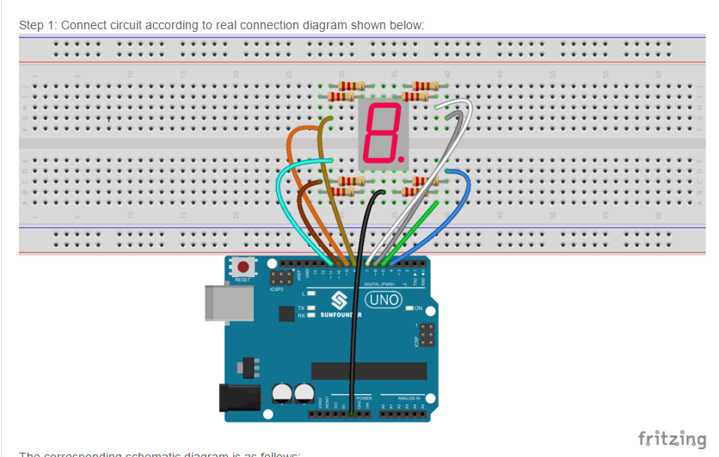
Build projects - Breadboard

Slide 10
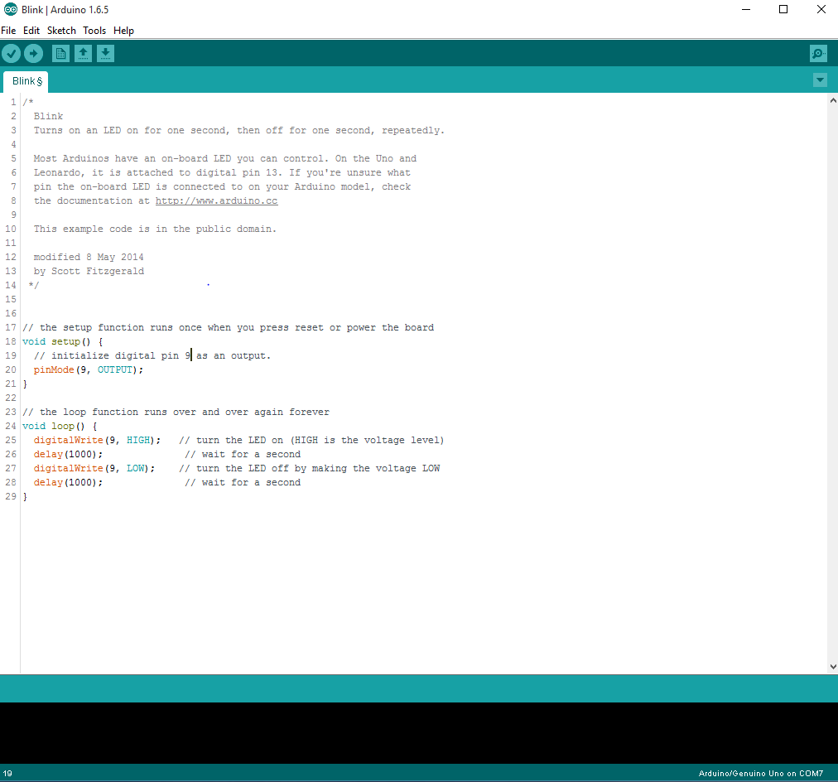
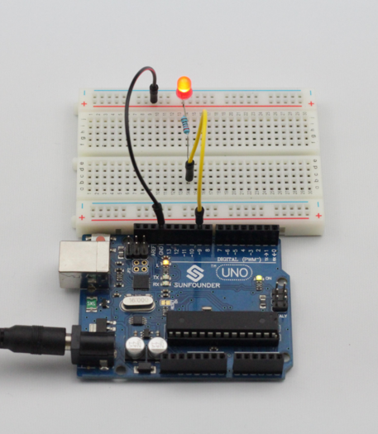
Arduino IDE

Slide 11
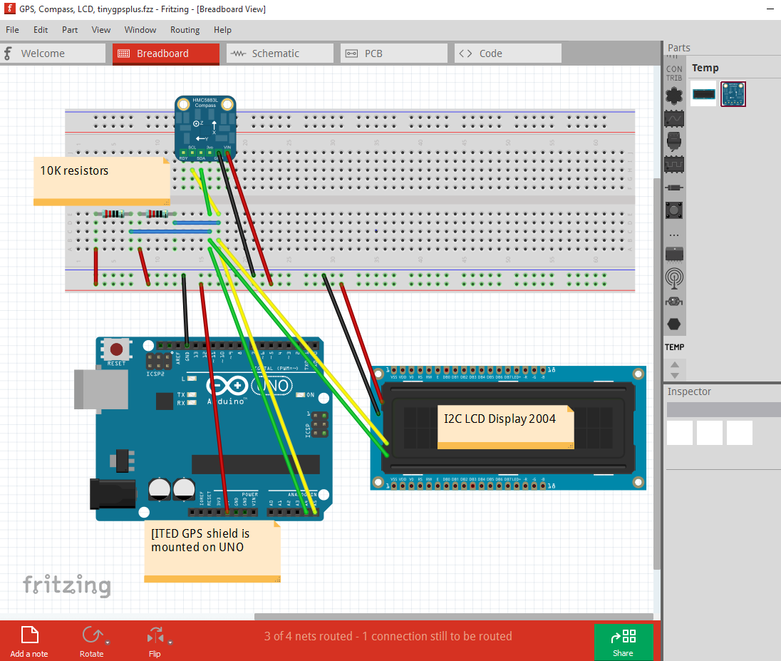
Fritzing

Slide 12
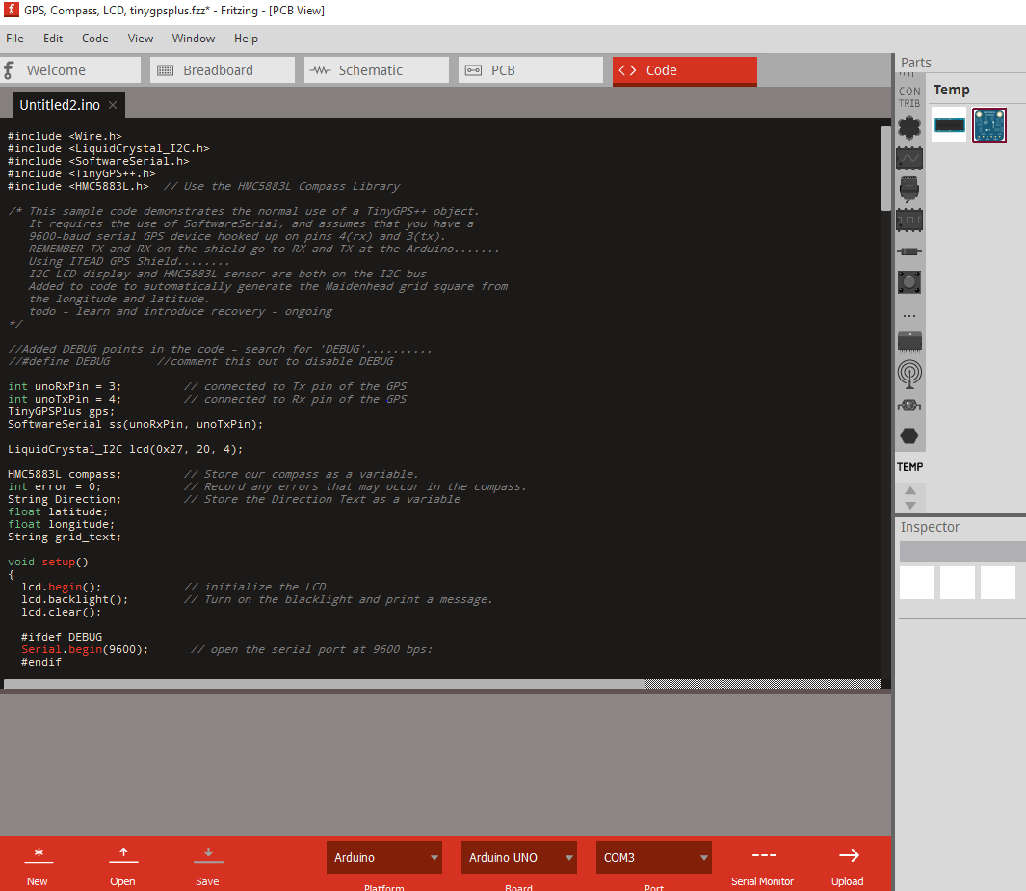
Fritzing

Slide 13
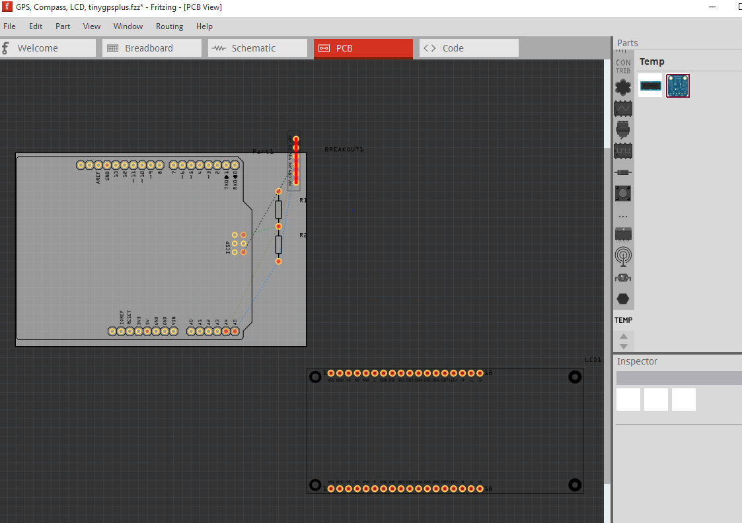
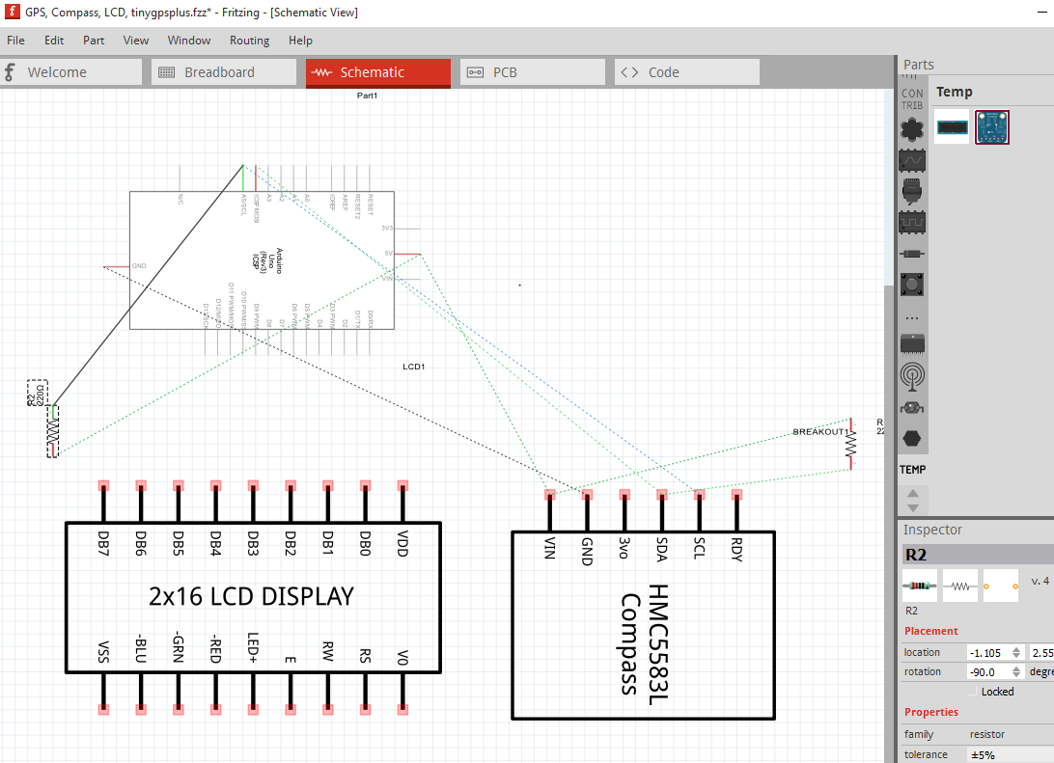
fritzing

Slide 14
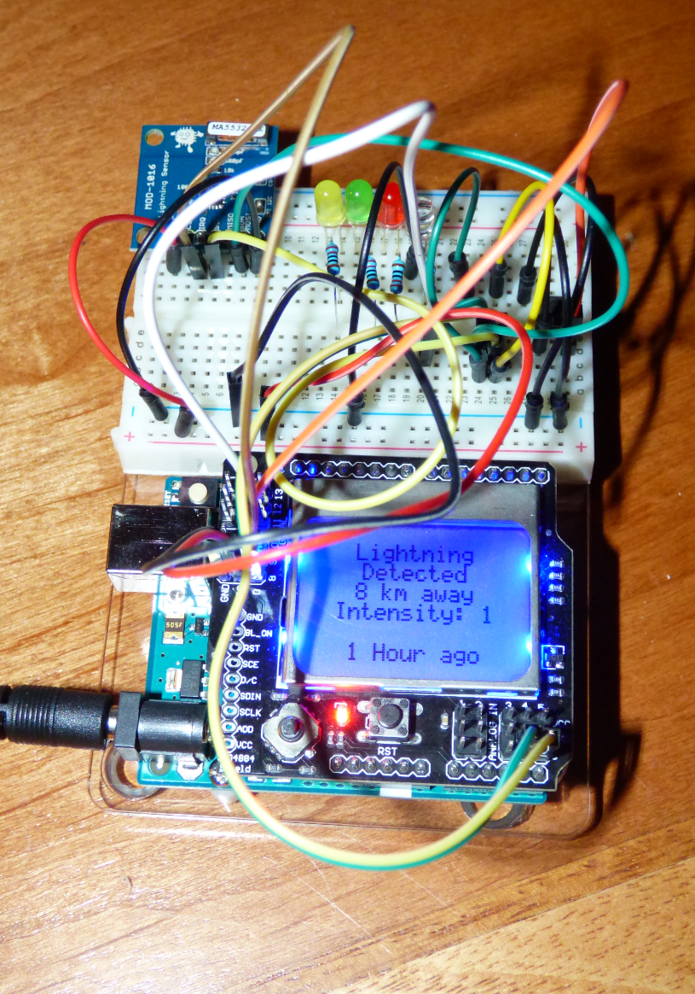
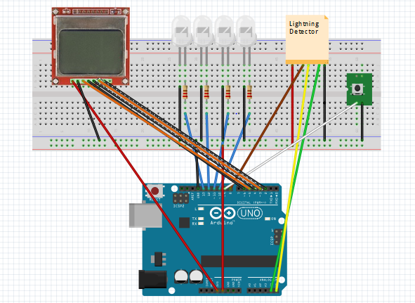
Lightning detector

Slide 15
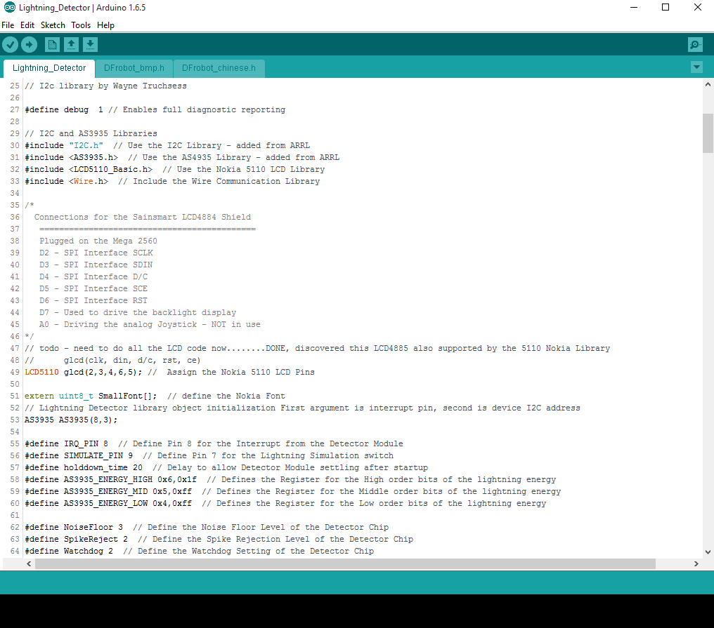
Lightning detector Sketch

Slide 16
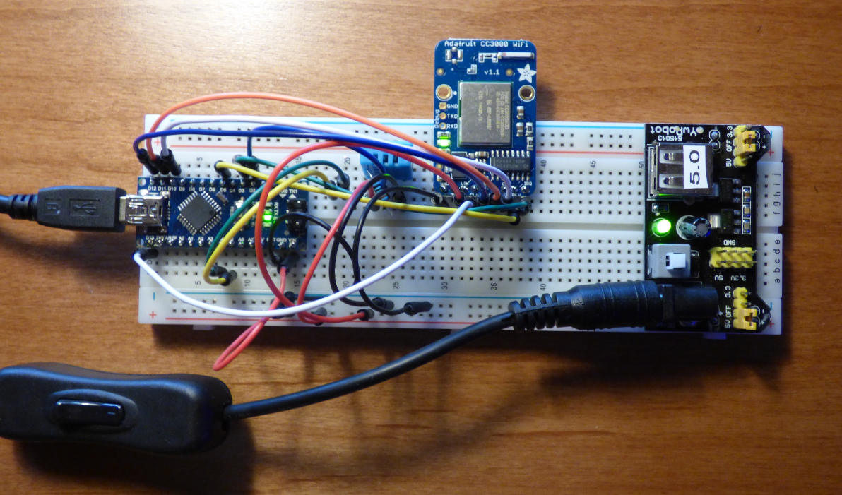
Home Automation

Slide 17
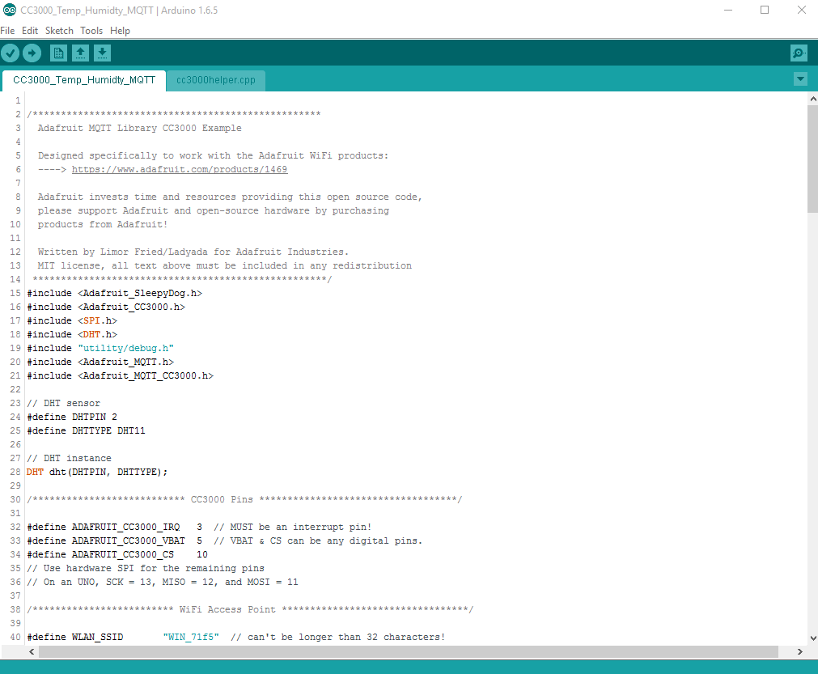
Home Automation Sketch

Slide 18
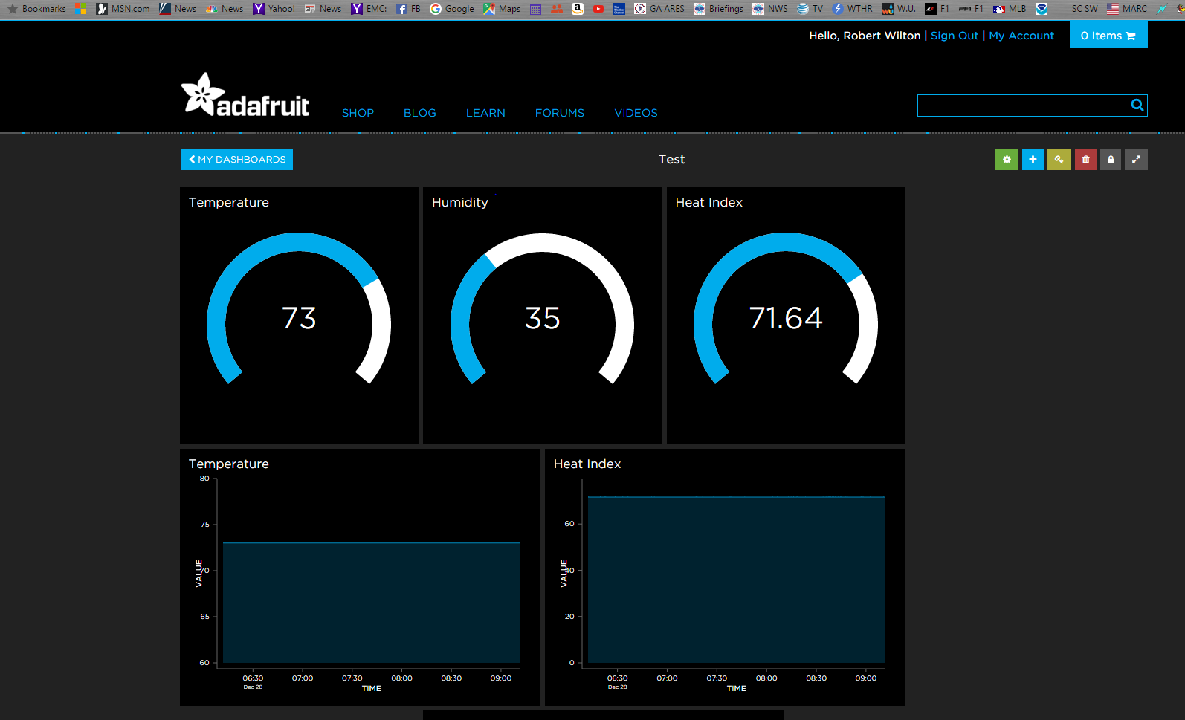
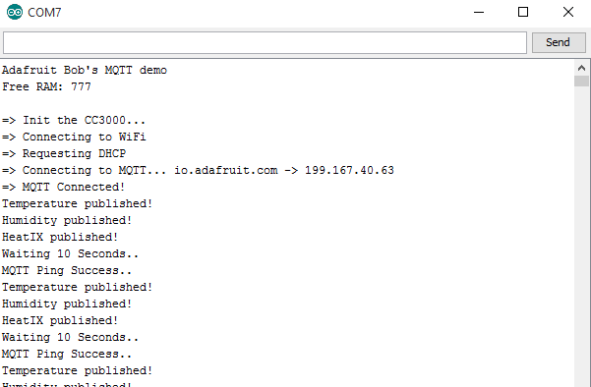
Adafruit io (publishing data)

Slide 19
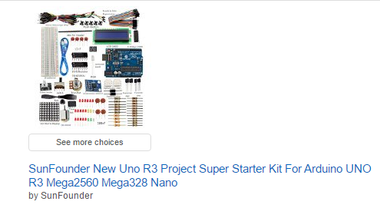
Getting started & Resources
Kits
www.Arduino.cc
www.adafruit.com
www.sparkfun.com
www.robotshop.com
www.sunfounder.com
www.amazon.com
Ebay
Google searches
www.github.com

